Slide 1


Home Monitoring System
Final Presentation

Slide 2

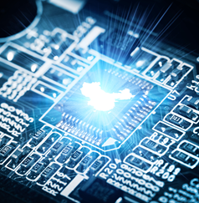
INTRODUCTION
DEMONSTRATION
PROBLEM AND OVERCOME
ADVICES FOR FUTURE
FUTURE IMPLEMENTATION

Slide 3
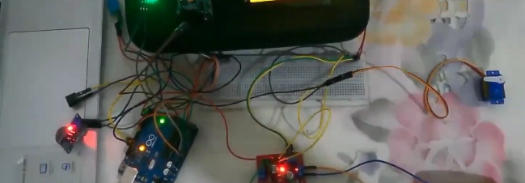
1
INTRODUCTION
Welcome to the presentation of our home monitoring system project, a versatile robotics project designed to enhance home security and automation using an Arduino Uno microcontroller. The system integrates multiple sensors and actuators to provide real-time monitoring and response to various environmental and security conditions within a home.

Slide 4
2
Demonstration of working Robot
Servo Motor for Door Control
16x2 LCD Display
The servo motor operates the door, allowing automated opening and closing based on sensor inputs.
The LCD display provides real-time data about the system's status, including temperature readings and alerts.
PIR Sensor for Person Detection and Alarm System
Buzzer for Alarms
The Passive Infrared (PIR) sensor detects the presence of a person. Upon detection, it triggers an alarm system to alert the occupants.
Buzzer is used to provide distinct alarm sounds for different alerts.
IR Sensor for Door Activation
DC Motor for Fan Control
An Infrared (IR) sensor is used to sense the presence of a person at the door. When someone approaches, the door automatically opens.
A DC motor is used to control a fan. The fan is activated when the temperature exceeds 30°C. If the temperature rises above 40°C, an additional alarm is triggered to indicate the extreme heat condition.
MQ-7 Gas Sensor
The MQ-7 sensor detects carbon monoxide levels in the environment. If dangerous levels are detected, an alarm is triggered to alert the occupants.

Slide 5
3
Problems Faced and How We Overcame Them
Integration Challenges
Power Management
Sensor Calibration
Environmental Interference

Slide 6
01
Integration Challenges
Problem: Integrating multiple sensors and actuators with the Arduino Uno posed significant challenges, including limited I/O pins and managing simultaneous operations.
Solution: We used an I2C device to connect the LCD display, thereby reducing the number of pins needed.

Slide 7
02
Sensor Calibration
Problem: The PIR and IR sensors required precise calibration to avoid false positives and ensure reliable detection.
Solution: We conducted extensive testing and fine-tuning of sensor thresholds and placement to achieve optimal sensitivity and accuracy.

Slide 8
03
Power Management
Problem: Managing power consumption with multiple components running simultaneously was a challenge.
Solution: We optimized the power usage by implementing sleep modes for sensors and actuators when not in use, and used a dedicated power supply to ensure stable operation.

Slide 9
04
Environmental Interference
Problem: Environmental factors such as lighting and temperature fluctuations affected sensor readings.
Solution: We used shielding and appropriate sensor placement to minimize interference. Additionally, software filters and algorithms were implemented to smooth out sensor data.

Slide 10


4
Advices for future researchers
Start with a Clear Plan: Define the scope and objectives of your project clearly before beginning the development process.
Modular Design: Design your system in a modular way so that components can be tested and replaced independently.
Thorough Testing: Conduct thorough testing under different conditions to ensure reliability and robustness.
Documentation: Keep detailed documentation of your design, code, and troubleshooting steps to facilitate future modifications and improvements.
Community Resources: Utilize online communities and resources for troubleshooting and gaining insights into best practices.

Slide 11


5
Future Implementations
Remote Monitoring and Control: Integrate IoT capabilities to allow remote monitoring and control of the home monitoring system through a smartphone app.
Advanced Analytics: Implement data analytics to provide insights and trends based on sensor data, enhancing predictive maintenance and security.
Voice Control: Add voice control capabilities using platforms like Amazon Alexa or Google Assistant for hands-free operation.
Enhanced Security Features: Integrate facial recognition or fingerprint sensors for enhanced security at the door.
Energy Management: Implement smart energy management systems to optimize power consumption based on real-time data and usage patterns.

Slide 12
THANK YOU
for your attention and interest in our Home Monitoring System project. Your feedback and questions are greatly appreciated!

